Slide 1
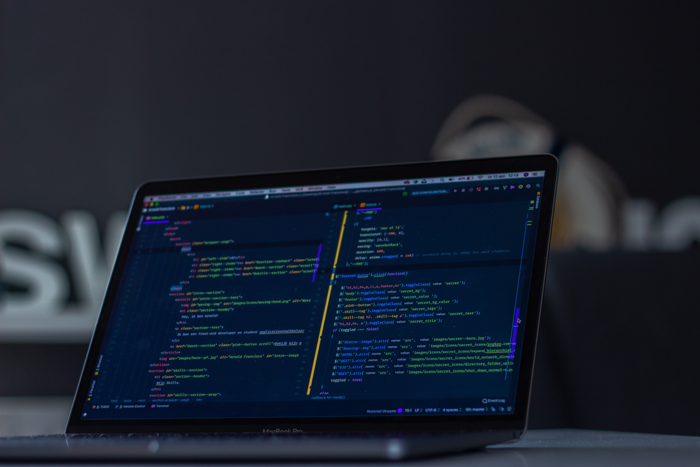
Pointers
If only they pointed you in the right direction
Prepared by Simeon Ramjit

Slide 2
What is a pointer?
We’ll get there soon, we first need to evaluate how we’ve been handling variables all this time
It was done by declaring a datatype, variable name and then an assignment to some value
The operating system decides where in memory (RAM) that variable will live
That place also has a memory address. Normally, to use the variable we use the variable name, however it may be useful to use the address of the variable instead.

Slide 3
Variable Address
To get the address of a variable, we need to use the address-of operator, &
Run this program again, note the different address on every run but the same value
The OS will usually place it in a different place in memory every time.
#include<iostream>
int main() {
int myvariable = 90; //declare and init variable
std::cout << &myvariable << std::endl; //print address of variable
std::cout << myvariable << std::endl; //print value of variable
return 0;
}

Slide 4
Variable Address
The ability to access the address of a variable means we can use the address of variable in calculations or pass them into functions for a performance boost
When you use the variable name, you pass a copy of the variable which is slow. Using the address will help especially when your variables are large as in the case of arrays and vectors (pass by reference vs pass by value)

Slide 5
So, what is a pointer?
It’s a variable that stores the address of another variable.
They have the name pointer since they ‘point to’ the variable who’s address they store
Let’s assume we have ‘myvariable’ and then ‘mypointer’ has the address of ‘myvariable’

Slide 6
So, what is a pointer?
The value that a pointer has is the address of the variable it points to
Variable Name | Value | Address
myvariable | 90 | 0x80808080
mypointer | 0x80808080 = ‭2,155,905,152‬ | 0x11110000

Slide 7

Pointers in C++
Pointers themselves have to match the datatype of the variable they’re pointing to
Pointers have a special declaration in C++
To get the value of the variable that’s being pointed to from the pointer, the pointer has to be dereferenced
E.g. if we wanted the value of ‘myvariable’ from ‘mypointer’ we’d have to dereference ‘mypointer’
The dereference operator in C++ is *

Slide 8
Pointers in C++
#include<iostream>
int main() {
char mychar = ’A’;
int myint = 90;
//declare a character ptr and init with address of char variable
char* mycharptr = &mychar;
//declare an int ptr and init with address of int variable
int* myintptr = &myint;
std::cout << "The character value is: " <<*mycharptr
<<". The address is: "<< static_cast<void*>(mycharptr)
<<std::endl;
std::cout << "The integer value is: " << *myintptr
<< ". The address is: " << myintptr
<< std::endl;
return 0;
}

Slide 9
Pointers in C++
What is static_cast<void*>(mycharptr)?
When taking the address of mycharptr , you get char*. The operator << interprets that as a C string, and attempts to display a character sequence instead of the address
That was needed only to display the address correctly but the underlying address is there to be used as normal
Unlikely you’ll need this knowledge soon so don’t get bogged down with it

Slide 10
Pointers in C++
Sometimes we need to initialize a pointer but we don’t have use for it yet. In that case there exists nullptr
Do not use a pointer that has been initialized with nullptr unless a valid value have been written to it. That will result in undefined behaviour
int* myintptr = nullptr;

Slide 11
That’s a wrap!
Challenge for you
Create a function that adds two numbers but the arguments are passed via reference
Create a function that takes in array of 5 integers, increments each value by 1 and returns the modified array to main. Print the array before and after modification https://www.tutorialspoint.com/cplusplus/cpp_passing_arrays_to_functions.htm

Slide 12


Questions?
simeon.ramjit@sta.uwi.edu
github.com/simeon9696/programmingworkshop

